Slide 1
Heat and Mass balance TASK
Technical Development Program SPREAD 2016

Slide 2
Task 1: Mass balance
Compare the following dust measurements and integrate it in the balance
Close mass balance error

Slide 3
Finalization of mass balance:
Dust main filter:
In direct operation 2 h after raw mill stop
Two different measurements have been done:
1 m³ bin was filled in 8 minutes, mass 1250 kg
This measurement was repeated 3 times always with the same result.
20 t truck was filled in 84 minutes This measurement could only be done once due to the generation of fugitive dust, the Environmental manager forbid to repeat the measurement
Task: Which measurement do you consider? Fill in the value in cell D92! Check next page for further info!

Slide 4
Mass flows additional info
Clinker:
Clinker was separated for 24 h using the off-spec silo
This silo was continuously discharged to trucks
The trucks were weighed on the calibrated weigh bridge: 4029.6 t
Petcoke:
The Pfister feeders were calibrated before the balance (with loss of weight of feed bin) and calibration showed no significant error
For the balance duration, the average are: MB: 7 t/h, PC: 10.3 t/h
AFRs:
The new dosing equipment performance test has recently been done, where the feed amount was discharged to trucks to cross-check dosing accuracy, which resulted in minimal errors. The measured values were entered in the balance
Kiln feed:
The impact flow meter was calibrated beforehand (with loss of weight of feed bin) and the kiln feed bin was even cleaned on the outside from accumulated dust during the calibration

Slide 5
Task 2: Cooler air balance
Insert degree of calcination (Cell I429) of hot meal and discuss impact on cooler air balance
Insert the oxygen value after pre-calciner in balance (Cell I430) in the balance
Insert cooler waste air volume to close cooler air balance error (Cell I280)

Slide 6
Calcination degree
Determine the calcination degree according to the lab results:
LOI:
Kiln feed 35%
Main filter dust 36.5%
Hot meal 2.6 %
Clinker 0%
Enter correct value in cell I429
Formula → “PPE Reference guide”

Slide 7
Preheater exit, Precalciner measurements
Preheater exit:
O₂
Permanent O₂ measurement was cross-checked during the Balance, no error was found.
24 h average value from the fix installed analyzer is 3%
Temperature:
Fix installed temperature measurement was cross-checked, no error was found
24 h average taken for balance 340°C.
Pre-calciner exit O₂ (Cyclone 5 gas exit)
Only one manual measurement available: 5%. Repetition of this measurement was not possible due to broken probe.

Slide 8
Waste air, cooling air flow, tertiary air
Waste air:
Temperature is 24 h average of CCR value which was cross-checked beforehand: 300°C
Waste air flow was measured 3 times: result = 190’000 Nm³/h
Cooling air flow
Air flow set points of the fans were kept constant and in automatic control during the whole balance period
Each fan was measured once with the anemometer at the inlet.
In two fans, error > 5% to the value from the CCR were detected and confirmed with a repetition of the measurement. The manually measured values were inserted in the balance

Slide 9
Task 3: Cooler heat balance
Insert clinker inlet temperature (at kiln discharge) (Cell I446)
Insert tertiary air temperature (Cell I456) in balance
Insert clinker temperature (Cell D109) in balance
Close balance error according to procedure

Slide 10
Temperature measurements
Clinker inlet temperature
Pyrometer measurement showed 600°C but is was only possible to measure 3 times quickly in order not to burn the equipment. The equipment was the same as used for the kiln shell radiation measurement.
Which value do you consider for the balance? Enter it in cell I446
Tertiary air temperature
CCR value is 800°C (24 h average)
Measured value (4 times during balance) 850°C (CCR value 740°C at the times of the measurements)
Which value do you consider?

Slide 11
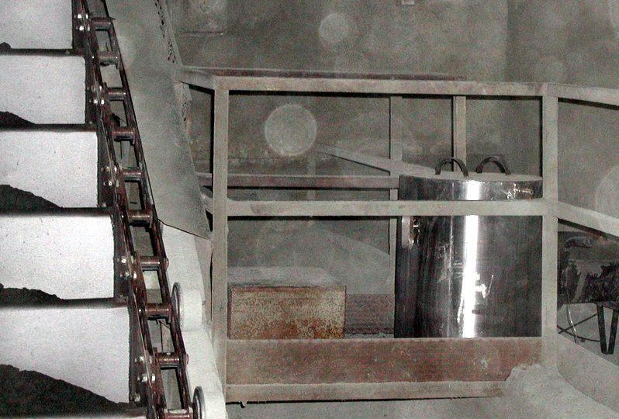
Clinker temperature
Measured with a box
Each hour filled from pan conveyor
Max Temp recorded with data logger
Calculate Average temperature insert it in Heat balance

Slide 12
Task 4: Kiln heat balance
Check now if kiln heat balance closes
Check measurements again for correctness, if necessary
Discuss measurement errors / certainty of values
Discuss: heat consumption value = fuel input

Slide 13

Notes:
Urs comes in here! He shows letter from CEO (paper copy shown with presenter(hellraumprojektor))
Received letter from CEO today
Urs needs to present at 18:30 to the CEO 30 min drive to Zürich
So he needs to leave at 18:00→ presentation at 17:50 max 5 Minutes

